Slide 1
CPU Scheduling
Course Instructor: Nausheen Shoaib

Slide 2
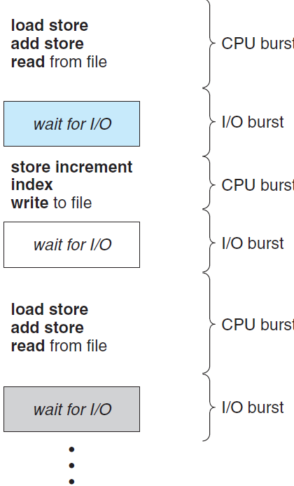
Basic Concepts
Maximum CPU utilization obtained with multiprogramming
CPU–I/O Burst Cycle – Process execution consists of a cycle of CPU execution and I/O wait
CPU burst followed by I/O burst
CPU burst distribution is of main concern

Slide 3
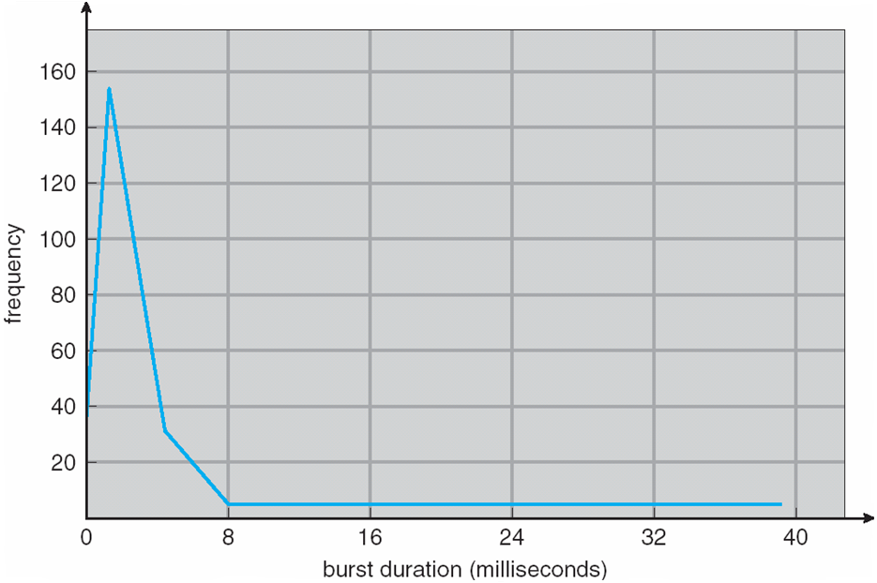
Histogram of CPU-burst Times

Slide 4
CPU Scheduler
Short-term scheduler selects from among the processes in ready queue, and allocates the CPU to one of them
Queue may be ordered in various ways
CPU scheduling decisions may take place when a process:
1. Switches from running to waiting state
2. Switches from running to ready state
3. Switches from waiting to ready
Terminates
Scheduling under 1 and 4 is non-preemptive
All other scheduling is preemptive
Consider access to shared data
Consider preemption while in kernel mode
Consider interrupts occurring during crucial OS activities

Slide 5
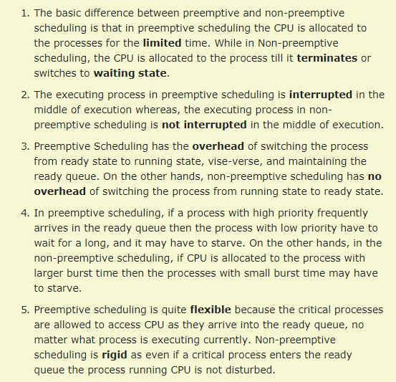
Preemptive Vs. Non Preemptive Scheduling

Slide 6
Dispatcher
Dispatcher module gives control of the CPU to the process selected by the short-term scheduler; this involves:
switching context
switching to user mode
jumping to the proper location in the user program to restart that program
Dispatch latency – time it takes for the dispatcher to stop one process and start another running

Slide 7
Scheduling Criteria
CPU utilization – keep the CPU as busy as possible
Throughput – # of processes that complete their execution per time unit
Turnaround time – amount of time to execute a particular process
Turnaround time (TAT)=Completion time – Arrival time
Waiting time – amount of time a process has been waiting in the ready queue
Response time – amount of time it takes from when a request was submitted until the first response is produced, not output (for time-sharing environment)

Slide 8
Scheduling Algorithm Optimization Criteria
Max CPU utilization
Max throughput
Min turnaround time
Min waiting time
Min response time

Slide 9
First-Come, First-Served (FCFS) Scheduling
Process Burst Time
P₁ 24
P₂ 3
P₃ 3
Suppose that the processes arrive in the order: P₁ , P₂ , P₃
The Gantt Chart for the schedule is:
Waiting time for P₁ = 0; P₂ = 24; P₃ = 27
Average waiting time: (0 + 24 + 27)/3 = 17
Response time: FR-AT=
P₁
P₂
P₃
0
24
27
30

Slide 10
Example FCFS
Covered in class

Slide 11
FCFS Scheduling (Cont.)
Suppose that the processes arrive in the order:
P₂ , P₃ , P₁
The Gantt chart for the schedule is:
Waiting time for P₁ = 6; P₂ = 0; P₃ = 3
Average waiting time: (6 + 0 + 3)/3 = 3
Much better than previous case
Convoy effect - short process behind long process
Consider one CPU-bound and many I/O-bound processes
P₂
P₃
P₁
0
3
6
30

Slide 12
Shortest-Job-First (SJF) Scheduling
Associate with each process the length of its next CPU burst
Use these lengths to schedule the process with the shortest time
SJF is optimal – gives minimum average waiting time for a given set of processes
The difficulty is knowing the length of the next CPU request
Could ask the user

Slide 13
Example of SJF
ProcessArriva l Time Burst Time
P₁ 0.0 6
P₂ 2.0 8
P₃ 4.0 7
P₄ 5.0 3
SJF scheduling chart
Average waiting time = (3 + 16 + 9 + 0) / 4 = 7
P₄
P₁
P₃
P₂
0
3
9
16
24

Slide 14
Example of SJF
Covered in class

Slide 15

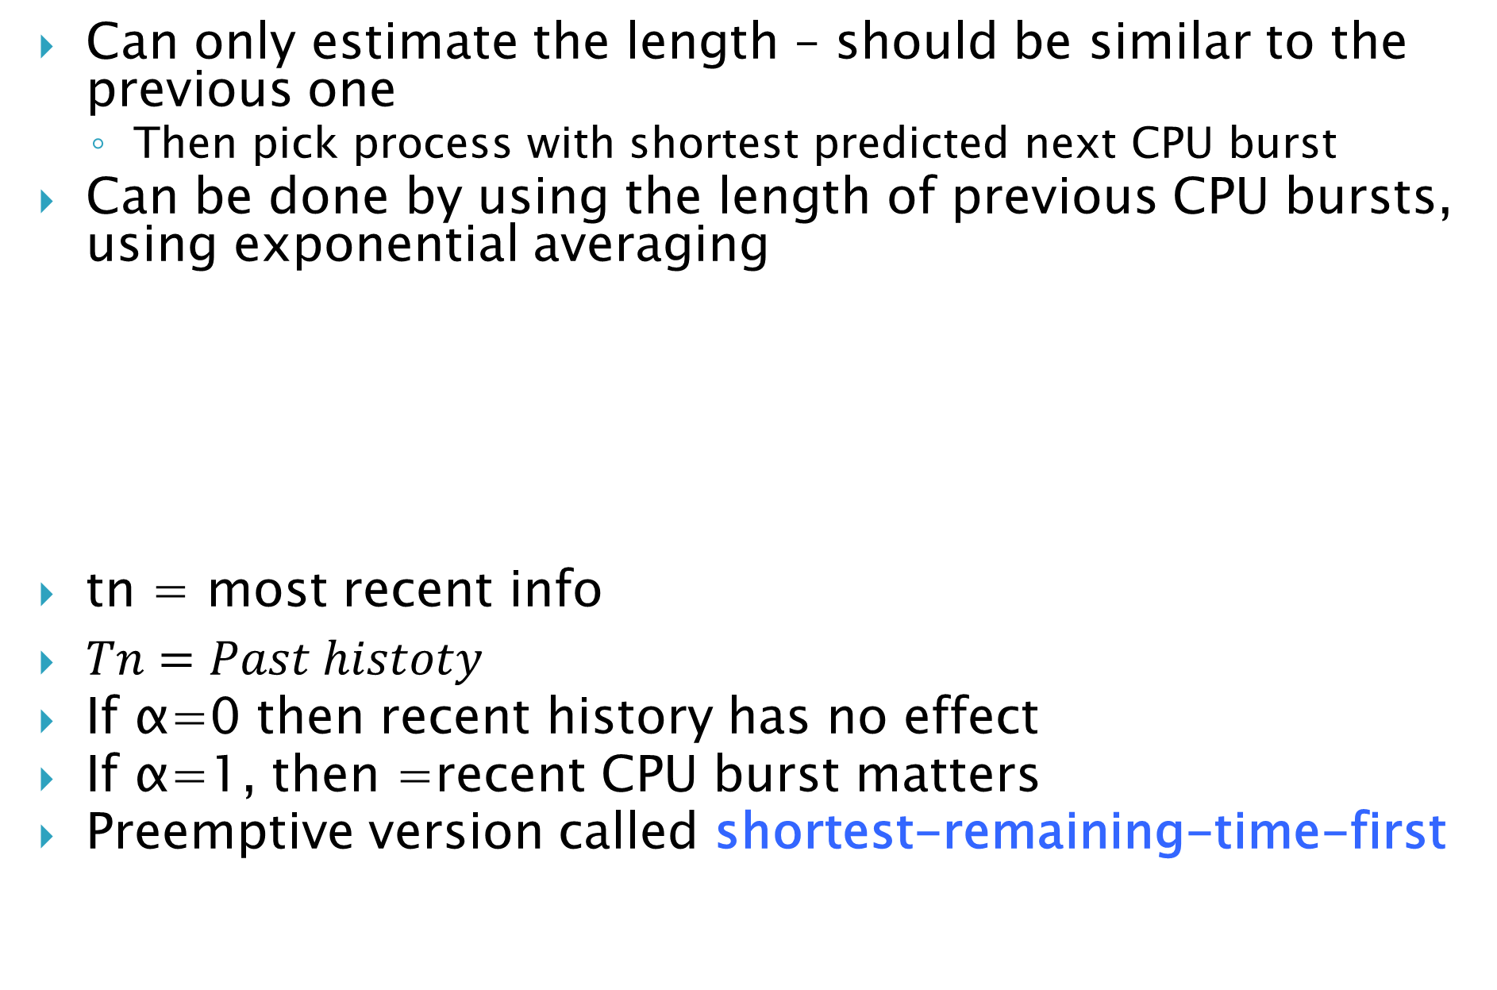
Determining Length of Next CPU Burst
Can only estimate the length – should be similar to the previous one
Then pick process with shortest predicted next CPU burst
Can be done by using the length of previous CPU bursts, using exponential averaging
tn = most recent info
$Tn=Past histoty$
If α=0 then recent history has no effect
If α=1, then =recent CPU burst matters
Preemptive version called shortest-remaining-time-first

Slide 16
Shortest-remaining-time-first
Now we add the concepts of varying arrival times and preemption to the analysis:
the process with the smallest amount of time remaining until completion is selected to execute.

Slide 17
Example of SRTF
Covered in class

Slide 18
Priority Scheduling
A priority number (integer) is associated with each process
The CPU is allocated to the process with the highest priority (smallest integer ≡ highest priority)
Preemptive
Non-preemptive
Problem ≡ Starvation – low priority processes may never execute
Solution ≡ Aging – as time progresses increase the priority of the process

Slide 19
Example of Priority Scheduling
ProcessA arri Burst TimeT Priority
P₁ 10 3
P₂ 1 1
P₃ 2 4
P₄ 1 5
P₅ 5 2
Priority scheduling Gantt Chart
Average waiting time = 8.2 msec
P₂
P₅
P₁
P₃
P₄
0
1
6
16
18
19

Slide 20
Example Priority
Covered in class

Slide 21
Round Robin (RR)
Each process gets a small unit of CPU time (time quantum q), usually 10-100 milliseconds. After this time has elapsed, the process is preempted and added to the end of the ready queue.
If there are n processes in the ready queue and the time quantum is q, then each process gets 1/n of the CPU time in chunks of at most q time units at once. No process waits more than (n-1)q time units.
Timer interrupts every quantum to schedule next process
Performance
q large ⇒ FIFO
q small ⇒ q must be large with respect to context switch, otherwise overhead is too high

Slide 22
Example of RR with Time Quantum = 4
Process Burst Time
P₁ 24
P₂ 3
P₃ 3
The Gantt chart is:
Completion time = P1=30; P2=7; P3=10
TAT =P1= (30-0); P2=(7-4); P3=(10-7)
Avg. TAT=

Slide 23
Example RR
Covered in class

Slide 24
Multilevel Queue
Process is assigned to one queue based on memory size, priority, process type.
Ready queue is partitioned into separate queues, eg:
foreground (interactive)
background (batch)
Each queue has its own scheduling algorithm:
foreground – RR
background – FCFS
Scheduling must be done between the queues:
Fixed priority scheduling; (i.e., serve all from foreground then from background). Possibility of starvation.
Time slice – each queue gets a certain amount of CPU time which it can schedule amongst its processes; i.e., 80% to foreground in RR
20% to background in FCFS

Slide 25
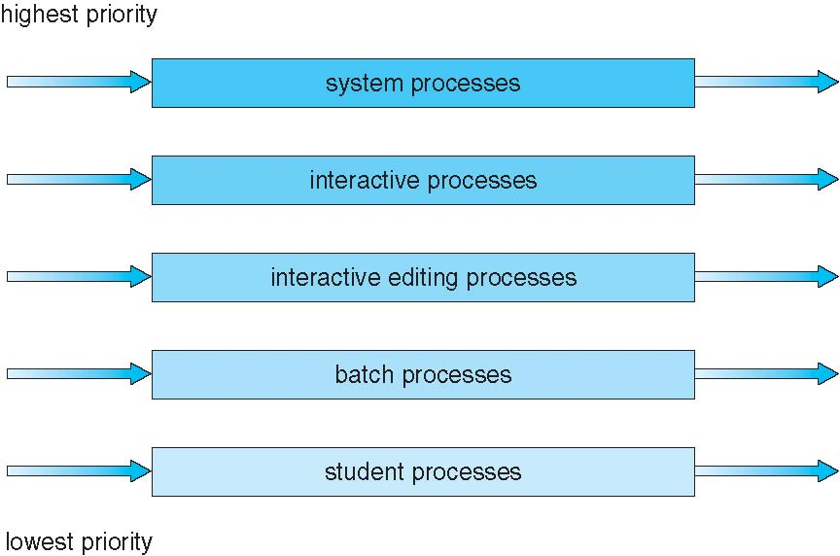
Multilevel Queue Scheduling

Slide 26
Multilevel Feedback Queue
Idea is to separate process according to CPU burst time
If a process uses too much CPU time, it is moved to low priority
If a process waits too long (aging) in low priority then it is moved to high priority
Multilevel-feedback-queue scheduler defined by the following parameters:
number of queues
scheduling algorithms for each queue
method used to determine when to upgrade a process
method used to determine when to demote a process
method used to determine which queue a process will enter when that process needs service

Slide 27
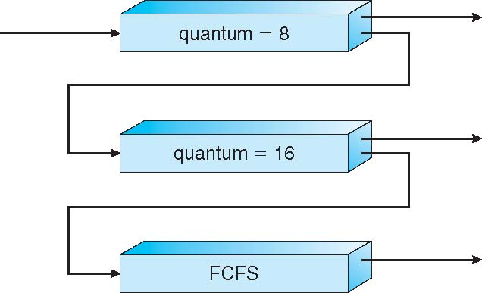
Example of Multilevel Feedback Queue
Three queues:
Q₀ – RR with time quantum 8 milliseconds
Q₁ – RR time quantum 16 milliseconds
Q₂ – FCFS
Scheduling
A new job enters queue Q₀ which is served FCFS
When it gains CPU, job receives 8 milliseconds
If it does not finish in 8 milliseconds, job is moved to queue Q₁
At Q₁ job is again served FCFS and receives 16 additional milliseconds
If it still does not complete, it is preempted and moved to queue Q₂

Slide 28
Multiple-Processor Scheduling
CPU scheduling more complex when multiple CPUs are available
Homogeneous processors within a multiprocessor
Asymmetric multiprocessing – only one processor accesses the system data structures, alleviating the need for data sharing
Symmetric multiprocessing (SMP) – each processor is self-scheduling, all processes in common ready queue, or each has its own private queue of ready processes

Slide 29
Multiple-Processor Scheduling
Processor affinity – process has affinity for processor on which it is currently running
soft affinity: When an operating system has a
policy of attempting to keep a process running
on the same processor—but not guaranteeing
that it will do so known as soft affinity.
hard affinity: allowing a process to specify a subset of processors on which it may run.

Slide 30
Multiple-Processor Scheduling – Load Balancing
If SMP, need to keep all CPUs loaded for efficiency
Load balancing attempts to keep workload evenly distributed
Push migration – periodic task checks load on each processor, and if found pushes task from overloaded CPU to other CPUs
Pull migration – idle processors pulls waiting task from busy processor

Slide 31
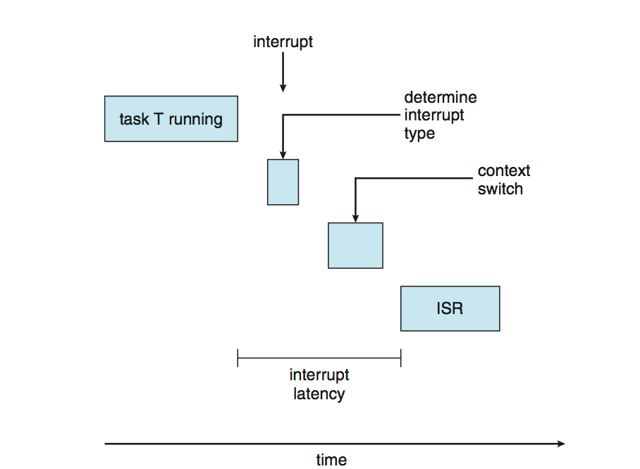
Real-Time CPU Scheduling
Soft real-time systems – no guarantee as to when critical real-time process will be scheduled
Hard real-time systems – task must be serviced by its deadline
Two types of latencies affect performance
Interrupt latency – time from arrival of interrupt to start of routine that services interrupt
Dispatch latency – time for schedule to take current process off CPU and switch to another

